Slide 1
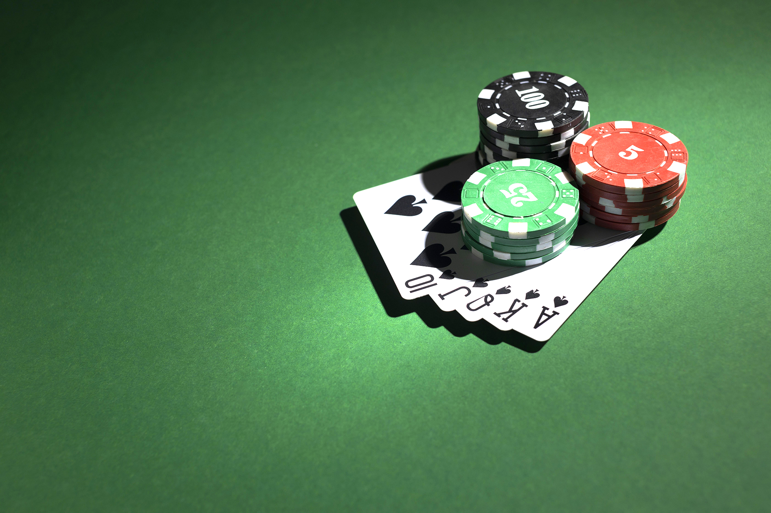
Develop a Poker Game Simulator with Expectiminimax
Group – 7
Group Members:
Md Simanto Haider 2021211042
Md Tajul Islam 2031210642
Sheikh Mushrure Zucky 1821178642
Md Taibur Rahaman 1931424642

Slide 2
Project Overview
Goal: Develop a Poker simulator with an AI for strategic decision-making in uncertain events.
Focus: Implement Expectiminimax algorithm for AI decision-making.

Slide 3
Why Poker is Challenging
Incomplete Information
Stochasticity
Opponent Modeling
Bluffing & Deception
Vast State Space

Slide 4
Strategic Decision-Maker: Expectiminimax Algorithm
A decision-making strategy designed for adversarial games with uncertainty.
Key Features:
1. Max node: Player chooses the action with highest expected utility.
2. Min node: Opponent chooses the action with lowest utility.
3. Chance Nodes: Calculate expected value of probabilistic outcomes
Why suitable for Poker:
1. Directly handles uncertainty
2. Optimal decision-making under risk
3. Integrates opponent play
4. Framework for complex scenarios

Slide 5
Core Components: We Plan to Develop
Poker Game Environment: This is the virtual table where the game happens.
We've set up the basic flow: dealing cards, and going through the betting rounds (Pre-flop, Flop, Turn, River).
It follows the standard rules for Texas Hold’em.
Players can perform actions like Fold (give up), Check (pass), Call (match a bet), Bet (place a new bet), or Raise (increase a bet).
Card & Deck Management: This handles all the cards in the game.
We have a digital representation of a standard 52-card deck.
It can shuffle the deck and deal cards to players and the table correctly.
It also knows how to evaluate hands to determine who has the best poker hand (e.g., a pair, a straight, a flush).
Player Setup: This defines how players are managed in the game.
We can distinguish between a human player and our AI player.
It keeps track of each player's chips (their "stack") and the total money in the middle ("the pot").

Slide 6

Project Timeline
Task | Status
Problem understanding | Done
Environment & components design | Done
pseudocode | Done
Full implementation | Next
Evaluation & testing | Next

Slide 7
Challenges
Too Many Options: The game has a huge number of possible situations, making it hard for the AI to think through everything.
Making Decisions Fast: We need the AI to make good choices quickly, not slowly.
Good Scoring: It's hard to make the AI's scoring system perfectly accurate.

Slide 8
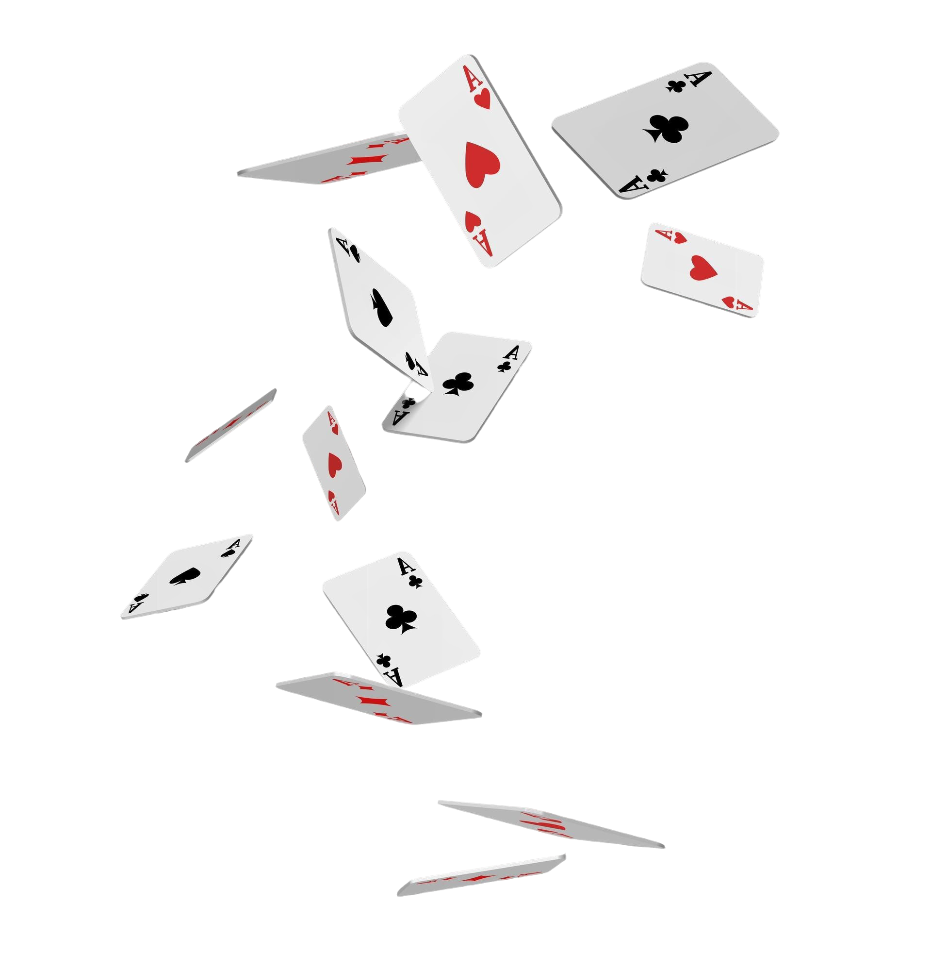
Thank You

